Slide 1
Mini-Project
Employee Performance Tracking System
Group Members Name :
Ansh Tripathi
Akash Modak
Ishaan Jain
Rajni Jha
Santanu Kumar
Yashika Bhambhani

Slide 2
Project overview
A system to manage employees, projects, and performance reviews.
HR and team leads can track assignments and evaluate performance.

Slide 3
Accomplishments
Designed a relational database (SQLite) to store employee and project data.
Integrated SQL and NoSQL databases (SQLite + MongoDB) for different types of data.
Built Python modules to manage employees, projects, and performance reviews.
Organized code into modular components for maintainability.
Implemented CRUD operations for storing and retrieving data.
Used SQL JOIN queries to generate employee–project reports.
Created a CLI-based application for managing company data.
Handled errors and ensured data integrity (e.g., duplicate email prevention).

Slide 4
Technologies Used
Python 3 – Application logic
SQLite – Relational database for structured data
MongoDB – NoSQL database for flexible review data
PyMongo – MongoDB Python driver
Pytest – Testing framework
Python-dotenv
Mongo Mock

Slide 5
System Architecture
User interacts with CLI (main.py)
Python modules handle business logic
SQLite stores employees and projects
MongoDB stores performance reviews

Slide 6
SQL Database Design
Employees Table Fields:
employee_id (Primary Key)
First_name
Last_name
email (Unique)
Hire_date
department
Projects Table Fields:
project_id (Primary Key)
Project_name
Start_date
End_date
status
Employee Projects Table (Junction Table):
assignment_id (Primary Key)
employee_id (Foreign Key)
project_id (Foreign Key)
role
assignment_date

Slide 7
NoSQL Database Design (MongoDB)
review_id – Unique identifier for each review (automatically generated by MongoDB _id)
employee_id – ID of the employee being reviewed (links to Employees table in SQL)
review_date – Date when the performance review was conducted
reviewer_name – Name of the person who conducted the review
overall_rating – Numeric rating given to the employee (e.g., 1–5)
strengths – List of key strengths demonstrated by the employee
areas_for_improvement – List of areas where the employee can improve
comments – Additional feedback about the employee's performance
goals_for_next_period – Goals assigned for the next review period

Slide 8
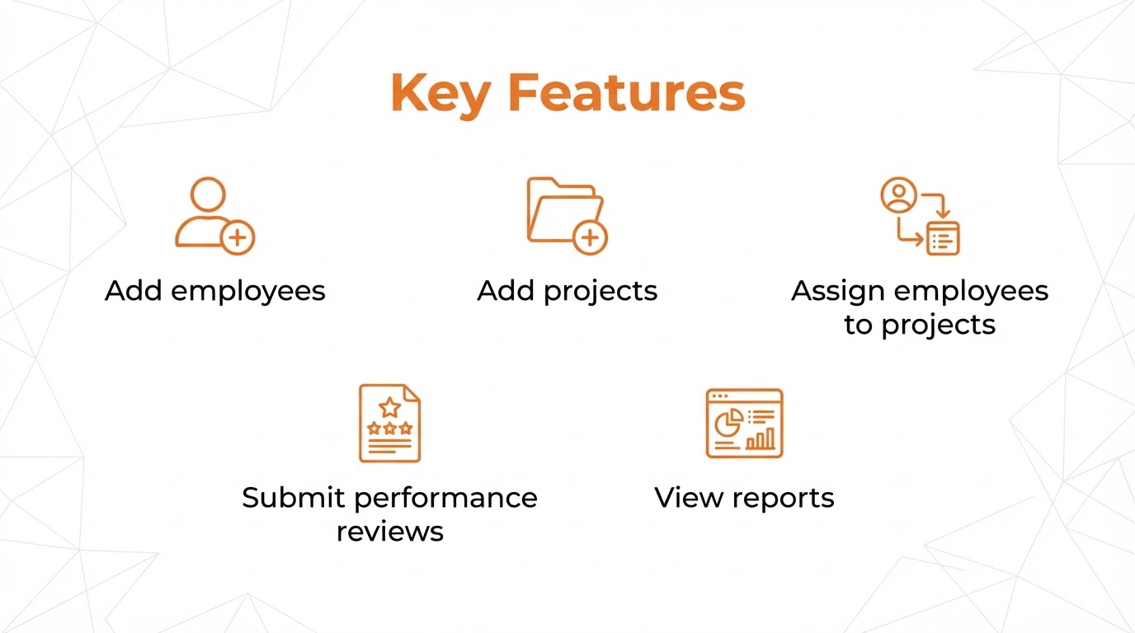

Slide 9
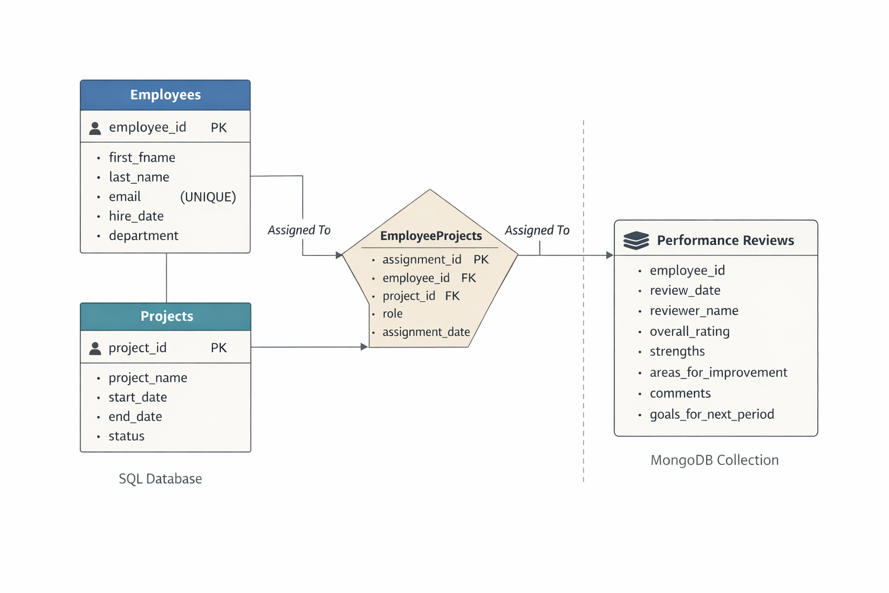
ER Diagram

Slide 10
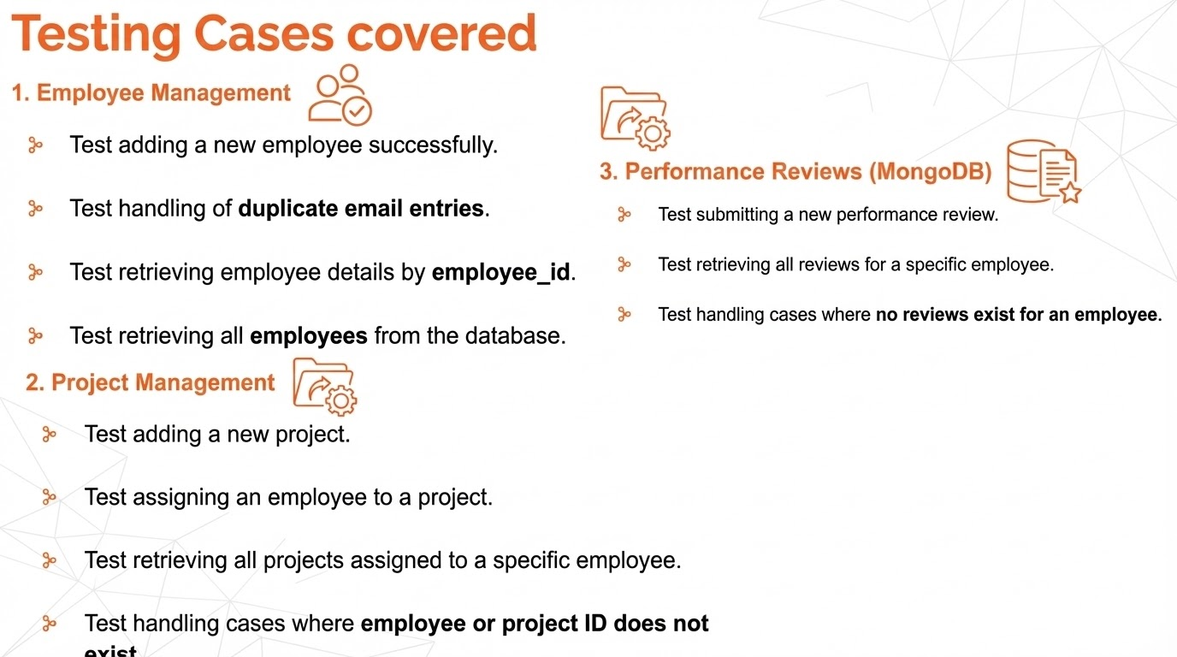

Slide 11
Conclusion
This project demonstrates how to build a data-driven system using Python, SQL (SQLite), and NoSQL (MongoDB) to manage employee data, project assignments, and performance reviews. It highlights database design, CRUD operations, reporting, and modular application development, providing practical experience in handling structured and semi-structured data efficiently.

